Slide 1
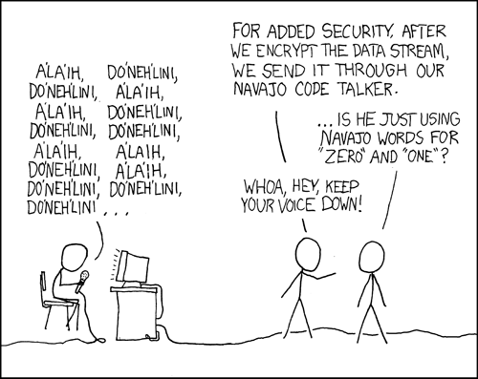
INFO3068 Secure Computing: PHP
Notes:
http://xkcd.com/257/
Revised for Fall 2020

Slide 2
Upcoming Events
Activity F02 XAMPP

Slide 3
Recap
We considered security and the approach for this course

Slide 4
PHP

Slide 5
Objectives
Coding in PHP
Security issues
Notes:
What is PHP?
What does PHP stand for?
How it works.
History
Who invented it and how it got to where it is today?
Features
Why choose PHP?
Basic Configuration
How and where to get installation information.
How to change PHP’s behaviour once it is installed.
First PHP script.
A basic script to ensure that it is installed on everyone’s machine correctly.

Slide 6
What is PHP?
Originally Personal Home Pages but now PHP: Hypertext Preprocessor
Web site: www.php.net
As with other server-side scripting languages, you have the ability to insert code in web pages
Notes:
PHP: Hypertext Preprocessor
Was originally known as Personal Home Page but now stands for PHP: Hypertext preprocessor.
Home page on the web www.php.net
The home page for php is www.php.net. There you will find:
Installation files
Online reference manuals
Php web links
Support mailing lists
It is a server side scripting language designed specifically for the web.
Server side scripting language usually written in an HTML context.
Basically the code is embedded within or interspersed with HTML tags.
Unlike an ordinary HTML page a PHP script is not sent directly to a client by the server instead it is parsed by the PHP engine.
HTML elements in the script are left alone, but PHP code is interpreted and executed.
Then the output from the PHP interpretation and the juxtaposed HTML tags results in a final HTML page which is sent back to the user.
PHP code in scripts can query databases, create images, read and write files, talk to remote servers, all with just a few lines of code
Conceived by Rasmus Lerdorf in 1994 – 1995 time frame.
Some references indicate 1994 others indicate 1995.
He wrote a Perl/CGI script that enabled him to know how many visitors were reading his online resume.
The script did two things:
First it logged visitor information.
Second it displayed the count of visitors to the web page.
Originally just a set of macros to help coders maintain Personal Home Pages.
The web still relatively immature at the time so tools like this were unprecedented and other people started asking about them.
Lerdorf started giving away his toolset and dubbed it Personal Home Page
PHP 2.0 or PHP-FI (Form Interpreter) was the second major release.
Lerdorf started working on additions to PHP one of which converted data entered in an HTML form into symbolic variables that allowed for their export to other systems.
This was also the release where Lerdorf moved from Perl/CGI scripts to C code.
This release was also accompanied by a number of other enhancements and improvements from other programmers worldwide.
In 1997 Version 3.0 released to over 50,000 users
After the release of 2.0 a core team of developers was formed and they undertook the task of rewriting the parsing engine.
The result was version 3.0 of PHP. At this point only two years after its conception more than 50,000 users were using PHP on their websites.
It was in this version of PHP that the name changed from Personal Home Page to PHP: Hypertext Preprocessor.
In 2000 version 4.0 released with the Zend parsing engine.
With the release of 4.0 the major goal was to build an even more robust and powerful parsing engine.
This was done because in it’s previous versions the developers had not intended that large-scale applications were going to be built using PHP.
With the introduction of the Zend parsing engine performance increased by several orders of magnitude.
Some PHP 3 scripts ran up to 200 times faster with this new release.

Slide 7
PHP
Key Benefits: Familiarity, Simplicity, Flexibility, Open Source
Website
www.php.net
Configuration is accomplished via php.ini file
Value Directives
Flag Directives
Positive Terms can be 1, On, Yes, True
Negative Terms can be 0, Off, No, False
ASP.net
similar to web.config
Notes:
Familiarity
Many of the language constructs are borrowed from languages such as C, C++, Perl and Java.
Developers who are familiar with these languages are able to start coding right away.
Simplicity
Because it is an interpreted language there is no need to include libraries or have special compilation directives.
The PHP engine simply begins interpreting code after the first escape sequence, a special set of characters that demark the start and end of PHP code, until it passes the closes escape sequence.
Efficiency
With the introduction of the Zend parsing engine PHP is now a viable choice for implementing large scale applications.
Zend also offers the Zend Optimizer which can increase the performance even further. Benchmarks have shown a performance gain of anywhere from 40 to 100 percent with the Zend Optimizer.
A commercial addition to the Zend Engine will be the facility for compiling PHP scripts. This will provide yet another gain in performance that should leave competitors like ASP, Perl and Java servlets behind.
www.zend.com
To find out more about Zend Technologies go to www.zend.com.
Security
System Level
At the system level PHP can be run in safe mode which can limit users’ attempts to exploit the PHP implementation.
Limits can be placed on system usage to control server performance degradation.
Restrictions can be placed on locations in which users can view and execute scripts.
Application Level
At the application level there are data encryption options in the PHP function set.
Also the source code isn’t viewed by the user because the script is completely parsed before being sent back to the user.
Flexibility
PHP can be used in conjunction with HTML, Javascript, WML, XML and many others.
No browser dependency.
Largely platform independent. You can develop and test a project with Personal Web Server and then deploy it on a UNIX system running PHP as an Apache module.
Cost
Basically free
Open Source Initiative
PHP is part of the Open Source Initiative
www.opensource.org
If you don’t know what that is you should. You can find out more information on the initiative at www.opensource.org.
Basically it means that you benefit from an accessible and committed community who offer a wealth of experience in the subject.
Chances are that any problems you encounter in your coding can be answered swiftly and easily with a little research.
Also there is no vested interest in a particular product or operating system

Slide 8
PHP Security?
The basics from phpsec.org:
Consider illegitimate uses for your code
Educate yourself
If nothing else, FILTER ALL EXTERNAL DATA

Slide 9
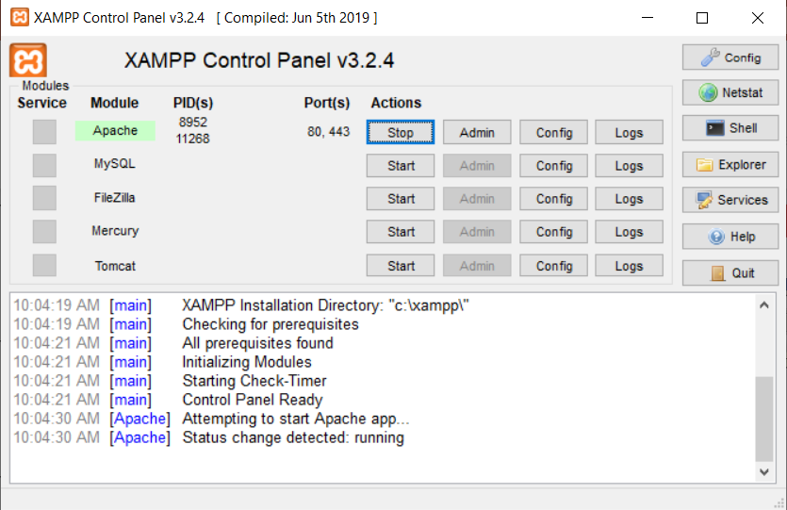
Lab Activity F02: Setup XAMPP environment
There is no Activity 01 this year, we begin with Activity 02
Notes:
Old notes, we will not be using VM this year:
http://ity-ftp.fanshawec.ca/
In VMWare directory, there is an installer and a licence key for VMWare Workstation
Password for virtual machine users is Windows1

Slide 10
Using XAMPP
Assuming you used c:\xampp as the installation directory, save your .html and .php files to the content directory c:\xampp\htdocs
And, do not open the .php file directly. Be sure you open your browser and surf to http://localhost/

Slide 11
PHP Code Example #1: helloworld.php
<html>
<head>
<title>A wonderful PHP page</title>
</head>
<body>
<?php
/* this is a comment, you won't see this */
print ("<h1>Hello world!</h1>");
?>
</body>
</html>

Slide 12
Let's Code #1
Try the "hello world" example from the previous slide
Save it as helloworld.php
Open browser and surf to your new page http://localhost/helloworld.php

Slide 13
Let's Code #2
Let's combine HTML and PHP
<html>
<head>
<title>A PHP script including HTML</title>
</head>
<body>
<b>
<?php
print ("Hello Web!");
?>
</b>
</body>
</html>

Slide 14
Things to note
The browser receives HTML
User will not see your PHP code
Can have as many <?php ?> blocks as you need spread throughout your HTML
You could use the informal <? ?> block notation instead but for style reasons many people like the more formal <?php ?>

Slide 15
Let's Code #3
Add this line inside your code block:
phpinfo();
What do you see as output?
phpinfo() is a built-in function
Anytime you want information on a built-in function, surf to www.php.net/functionname
Example: www.php.net/phpinfo

Slide 16
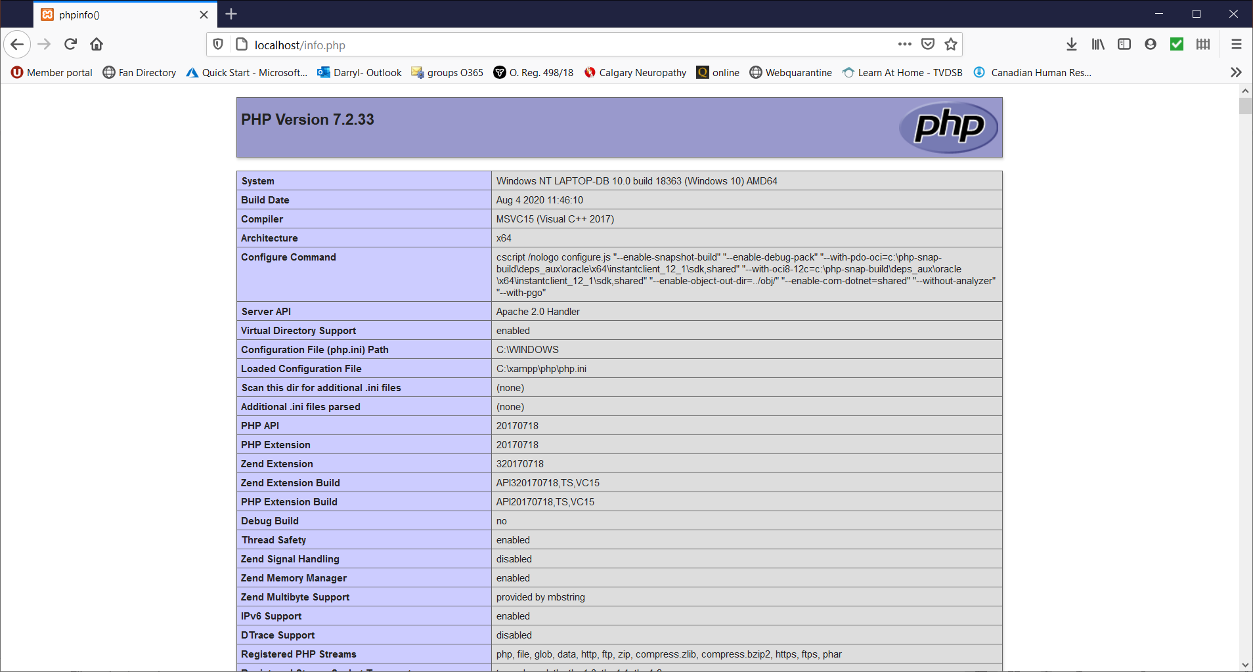

Slide 17
PHP Comments
If you know how to comment in C# or Java, you now how to comment in PHP!
/* some comments */
// one-line comment
# a UNIX-style one-line comment

Slide 18
Identifiers in PHP
$some_Var6 = "a value";
Variables in PHP start with a $ sign, then a letter or an underscore
The rest of the name can be letters, numbers, underscores
Case sensitive
Notes:
Cannot use a PHP keyword as a variable name

Slide 19
Arrays
Each item in an array can be accessed directly via its index, starting at 0 for the first element
In PHP, you can also access an element by name
When you submit an HTML form with data in it, it is passed in as an array.
Example:
$_POST['formfield']
$_GET['formfield']

Slide 20
Let's Code #4
Try this:
$name = "Lisa";
print("Hello $name"); // Hello List
print('Hello $name’); // Hello $name
What happened?
Can you tell based on this example what the difference is between single quotes and double quotes?
Double quotes (" ")
PHP will interpolate variables inside the string.

Slide 21
Print vs. Echo
The only difference between print and echo is that print can return an error code that can be checked… 1 if it worked, 0 if it did not
print returns an int
echo returns void
What is void?
void is a return-only type declaration indicating the function does not return a value, but the function may still terminate. Therefore, it cannot be part of a union type declaration

Slide 22
PHP Example #5
<html>
<head>
<title>PHP Example 1b</title>
</head>
<body>
<?php
#yes I am a shell script fanatic
echo "Hello world!";
?>
</body>
</html>

Slide 23
PHP statements
If you know how to code an if statement in Java, you know how to do it in PHP!
if ($cond_one && $cond_two)
{
//do this
}

Slide 24
PHP statements
Consider the following code:
<?php
if ($cond_one && $cond_two)
{
?>
<h1>This is some HTML!</h1>
<?php
}
?>
Is it valid? How does it work?
YES! PHP allows you to jump in and out of PHP mode using <?php ... ?>

Slide 25
PHP statements
If you know how to code a loop in Java, you know how to do it in PHP!
for ($i=0; $i<5; $i++)
{
/* do this */
}

Slide 26
Let's Code #5
Add a for loop to your "hello world" example that prints “hello world” a random number of times.
<?php
# Pick a random number between 1 and 10
$times = rand(1, 10);
# Loop and print "Hello world" that many times
for ($i = 0; $i < $times; $i++) {
echo "Hello world!<br>";
}
echo "<p>Printed $times times.</p>";
?>

Slide 27
PHP Variables

Slide 28
Identifiers in PHP
Identifiers in PHP can begin with a letter or an underscore
Any length
Consist of letters, numbers, underscores and other ASCII characters from 127 through 255
Case sensitive
Cannot use any of PHP keywords
Example:
$some_Var6 = "a value";

Slide 29
Variables (continued)
PHP variable names are preceded by a dollar ($) sign.
$test = "Joe";
print "hi there $test";
print 'hi there '.$test;
Note how you add strings together in PHP: use a . (dot) NOT a plus sign

Slide 30
Let's Code #6
Create two variables, $x and $y
Assign numbers to them
Add the two numbers together and save the result in $z
Print the result
<?php
$x = 5;
$y = 10;
$z = $x + $y;
echo "The result of adding $x and $y is: " . $z;
?>

Slide 31
Substitution Shortcut
Instead of <?php echo $x; ?>
If short tags are enabled in php.ini, you could use <?= $x ?>
This is particularly useful when you need to insert a lot of values into a web page
<input type='text' name='user' value='<?= $user ?>'>

Slide 32
Let's Code #7
Test to see if the value of $z is 15
if ($z == 15) {
echo "Yes, the value of \$z is 15.";
} else {
echo "No, the value of \$z is not 15.";
}

Slide 33
Let's Code #8
Print out the value of this expression:
2 + 2 * "nonsense" + TRUE
Why is this valid syntax?
What is the answer? Can you figure out why?
Does this present a security problem?

Slide 34
$result = 2 + 2 * "nonsense" + true;
// * has higher precedence than +
What PHP does:
"nonsense" → converted to 0 when used in arithmetic (and emits a warning in modern PHP).
true → converted to 1.
Evaluate: 2 * 0 = 0, then 2 + 0 + 1 = 3.
Why it’s valid: In arithmetic contexts, PHP auto-converts types: .
non-numeric strings → 0 true → 1, false → 0
Yes, it can be risky: Type juggling bugs (e.g., == comparisons where "0" equals 0 and false; "0e1234" can equal 0). Silent coercions can hide logic errors or enable auth/bypass vulnerabilities.

Slide 35
Security problem?
Yes, it can present security risks, especially if you are handling user inputs.
If PHP silently converts invalid or unexpected values, it could lead to:
Unexpected behaviors: Logic errors may arise if the code assumes a numeric value but
receives an unexpected type like a string.
SQL injection vulnerabilities: If you use input values without proper sanitization, attackers could exploit
implicit type conversions to inject malicious data.
Loose comparisons issues: Type juggling can cause problems with comparisons, especially when
comparing different types like strings, integers, or booleans (e.g., "0" == FALSE returns TRUE in PHP).

Slide 36
Safer Practices
Use strict comparisons (===, !==) instead of ==.
Validate inputs (is_numeric()), and cast explicitly.
Consider declare(strict_types=1); for stricter code.
Enable error reporting in dev to catch these warnings.

Slide 37
Data Types in PHP
Variables are loosely typed
Data types are determined automatically as data is assigned to a variable
Advantages: Variable can contain string at one point and an integer at another
Disadvantages: code may be expecting an array in a variable when the variable in fact contains an integer
However, there are ways of testing a variable's type and deliberately setting a variable's type in PHP

Slide 38
Reassigning Variables
Is this legal?
$my_num_var = "Should be numeric";
$my_num_var = 5;
Why or why not?
Does this cause a security problem?
Yes, reassigning variables dynamically in PHP, while allowed, can introduce security risks depending on the context in which it happens. The fact that PHP allows variables to change types on the fly can lead to vulnerabilities or bugs if not properly managed.

Slide 39
Standard Data Types
Type | Description
Integer | A whole number (decimal, octal starting with "0" or hex starting with "0x")
Floating-point Number | Real numbers (standard or scientific notation)
String | A collection of characters
Unlike other programming languages, PHP does not support a “character” or “char” data type but you can get individual characters out of a string:
echo $x{3};
echo $x{0};

Slide 40
Special Data Types
Type | Description
Boolean | One of the special values true or false
Object | Instance of class
Array | List of elements (indexed or associative)
Resource | Reference to a third-party resource (a handle database connection, for example)
NULL | An uninitialized variable
Constants | Unalterable values represented by an identifier

Slide 41
Strings
print "My Homepage";
print 'My Homepage';
print 'Darryl\'s Homepage';
print "Darryl's Homepage";
Special Characters
\n New line
\t Horizontal Tab
\\ Backslash
\$ Dollar Sign
\” Double Quotation Mark

Slide 42
Strings
String Literals are in ‘Single Quotation Marks’
These are true literals
No evaluation is done by the PHP engine so that variables in the middle are not substituted

Slide 43
Determining a Variable's Type
print gettype($test);
print is_int($test);
Also is_double, is_bool, is_null, is_string, is_array, is_object, is_resource
settype($test,"int");

Slide 44
Let's Code #10
Create an integer variable
Determine the variable's type and print out the result
<?php
$my_integer = 42;
print "The value is: $my_integer<br>";
print "The type is: " . gettype($my_integer);
?>

Slide 45
Constants
The value of a constant does not change
Must use define() function
Can only be a number or a string
Convention is to name constants using capital letters to distinguish them from variables
define ("PI", "3.141592");
Specify the name only, no dollar sign
print PI;

Slide 46
Data Types
Variable variables
Allows you to use the value of one variable as the name of another
A variable name preceded by another dollar ($) sign
e.g. $varname = “student_num”;
$$varname = 1211131; // is equivalent to
$student_num = 1211131;

Slide 47
PHP Comments
If you know how to comment in Java, you know how to comment in PHP!
/* some comments */
// one-line comment
# a UNIX-style one-line comment
Consider this style:
/*
* This is a block comment.
*/

Slide 48
PHP statements
If you know how to code an if statement in Java, you know how to do it in PHP!
if ($cond_one && $cond_two)
{
//do this
}
Note the brackets around the condition

Slide 49
Operators
and Both conditions must be true
&& and
or One of the conditions must be true
|| or
! The "not" operator
xor Exclusive or: one but not both
of the conditions are true

Slide 50
Boolean Constants
if (TRUE)
{
//this will always run!
}
if (FALSE)
{
//this will never run!
}

Slide 51
Operators
== Equal
!= Not Equal
< Less Than
> Greater Than
<= Less than or equal to
>= Greater than or equal to
=== Identical (new to PHP)

Slide 52
Let's Code #11
Try this example:
//a double equal sign
if ( 0 == "zero")
print("These are equal<br>");
//a triple equal sign
if ( 0 === "zero")
print("These are identical<br>");
else
print("These are not identical<br>");
Can you explain what happened?
Strict comparison (===) checks both the value and type of the variables

Slide 53
Ternary Operator
The ? or ternary operator works the same as in Java:
//Example 1
if ( $x == 0)
$y = 5;
else
$y = 6;
//Example 2
$y = ($x==0) ? 5 : 6;

Slide 54
Checkpoint
What are the values of $number1 and $number3 when you are finished?
$number1=2.5;
$number2=10;
$number3=12.5;
$number2 = $number1 + $number3;
$number1 = $number1 * 2 + 5;
$number3 = $number2 - $number1;
// $number2 = 15, $number1= 10, $number3= 5

Slide 55
Checkpoint
RUE because "todd" is lexicographically greater than "catherine"
Are the following IF statements TRUE or FALSE?
$num1 = 15;
$num2 = 6;
$name1 = "catherine";
$name2 = "Todd";
if ($num1 > 10 OR $num2 < 5 ) // True
if (strtolower($name2) > $name1) // True because “todd” comes after “catherine” lexicographically
if ($num2 == 6 AND ($name2=="todd" OR $num1<2)) //False

Slide 56
The End

Slide 57
What’s Coming
Topics such as these from phpsec.org plus a few more:
Register Globals disabled
Data Filtering
Dispatch method (MVC)
Including security code at the top of every page
Naming conventions
Timing
Error Reporting

Slide 58
Homework
Try out some sample scripts
Activity F02
Notes:
(If you want to buy the book, be sure to do so before they are returned by the bookstore)

Slide 59
References
www.php.net Official PHP site
http://www.securityspace.com
http://phpeditors.linuxbackup.co.uk List of editors for PHP
www.wikipedia.org
Notes:
www.troutworks.com/phpbook
Beighley and Morrison, Head First PHP and MySQL, O'Reilly.
Paul DuBois. MySQL.
Paul DuBois. MySQL Cookbook.
Julie C. Meioni. Teach Yourself MySQL and PHP

